Slide 1

Malla Reddy College of Engineering for Women
An UGC Autonomous Institution
Approved by AICTE New Delhi and Affiliated to JNTU
B.Tech. Programs CSE, ECE Accredited by NBA; An ISO 9001: 2015 Certified Institution
INDIA RANKINGS 2023 NIRF Innovation Rank Band 151-300; IIC 5.0 4-star Rating Maisammaguda, Medchal (Dist), Hyderabad -500100, Telangana.
Tel: 9346118802 Email : rg.mrcew@gmail.com, www.mrcew.ac.in
EAPCET CODE MREW JNTUH CODE RG
DEPARTMENT OF ELECTRONICS AND COMMUNICATION ENGINEERING
A MACHINE LEARNING FRAMEWORK FOR BIOMETRIC AUTHENTICATION USING ELECTROCARDIOGRAM
PRESENTED BY: UNDER GUIDANCE OF:
G V SIVANY 22RG1A0424 Dr.SELVAMANI INDRAJITH
G GAYATHRI 22RG1A0422 B.E.,ME.,Ph.D
G UMA DEVI 22RG1A0425 PROFESSOR AND HoD
S YUKTHIKA 22RG1A0452 DEPARTMENT OF ECE
PROJECT STAGE -1

Slide 2
OBJECTIVE OF THE PROJECT
The objective of this project is to design and develop a robust Machine Learning framework for biometric authentication using electrocardiogram (ECG) signals.
It provides a structured approach for adopting and adjusting Machine Learning techniques to construct ECG-based biometric authentication schemes.
This framework enables accurate and reliable biometric authentication using ECG signals, enhancing security and identity verification.

Slide 3
ABSTRACT
This project introduces a framework on how to appropriately adopt and adjust machine learning (ML) techniques used to construct electrocardiogram (ECG)-based biometric authentication schemes.
Magnetic resonance imaging (MRI) is used to detect and diagnose brain tumors. However, the manual identification of brain tumors from a large number of MRI images in clinical practice solely depends on the time and experience of medical professionals.
This paper aims to design an efficient framework for brain tumor segmentation and classification using deep learning techniques.
The study employs the 3D-UNet model for the volumetric segmentation of the MRI images, followed by the classification of the tumor using CNNs.

Slide 4
INTRODUCTION
Abnormal growth of cells or tissues in the brain can lead to a brain tumor. Neither the exact symptoms of a brain tumor nor the reasons that cause brain tumors are known today.
This research is based on 3D segmentation of MRI scan.
The MRI is an important tool for the detection, diagnosis, and monitoring of brain tumors. Effective classification and segmentation of MRI images is quite challenging.
The research work focuses on the development of an effective model that can help in the accurate identification of tumor automatically.

Slide 5
EXISITING SYSTEM:
Ultrasound images are having many different advantages like portability and low cost. But due to complex structure it is difficult to detect and segment regions exactly.
So author designed Deep learning approach for regularization in multi-domain.
Author showed that the existing methods are having drawbacks of time consuming, error-prone as well as depends on operator.
In order to overcome all the existing challenges DCAN(Deep counter aware network is proposed by author for better accuracy and perfect segmentation.

Slide 6
PROPOSED METHOD
SEGMENTATION: This refers to the process of identifying and delineating different regions or structures within medical images. In the context of brain tumor analysis, segmentation involves accurately outlining the boundaries of the tumor in 3D space. 3D U-Net is a type of neural network architecture primarily used for volumetric image segmentation tasks, particularly in medical image analysis.
CLASSIFICATION: Once the tumor regions are segmented, the next step is to classify the type or nature of the tumor. Brain tumors can be categorized into various types (e.g., gliomas, meningiomas), and their malignancy can also be assessed. Deep learning is a subset of machine learning that focuses on training deep neural networks with multiple layers to learn and represent complex patterns in data. Deep neural networks (DNNs)are composed of interconnected layers of artificial neurons that simulate the structure and functioning of the human brain.

Slide 7
FLOW CHART FOR PROPOSED METHOD
Selection of dataset
Pre-processing
Segmentation
Feature extraction
Classification
predication of single image

Slide 9
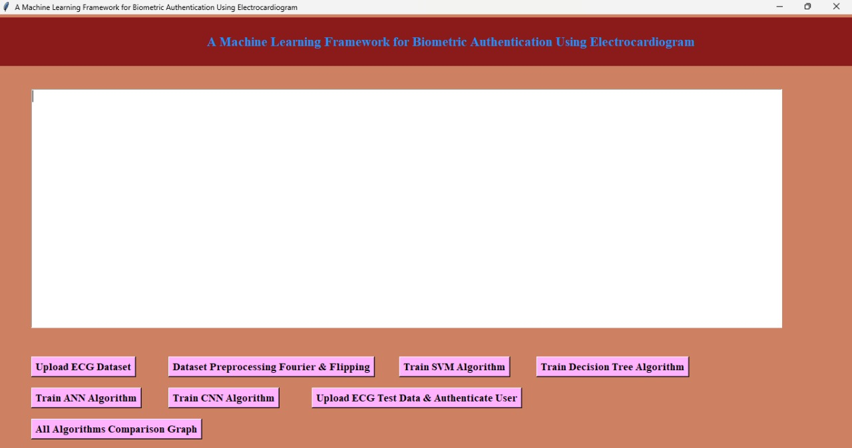
PROCEDURE:

Slide 10
REQUIREMENTS:
HARDWARE REQUIRED:
1.System Pentium IV - 2.4 GHz.
2.Hard Disk - 40 GB
3.Monitor - 15 VGA Colour.
4.RAM - 512 Mb.
5.Floppy Drive - 1.44 Mb.
SOFTWARE REQUIRED:
1.Operating System - Windows
2.Coding Language - Python 3.7
3.Tools Used - Python

Slide 11
.
Schematic Diagram

Slide 13
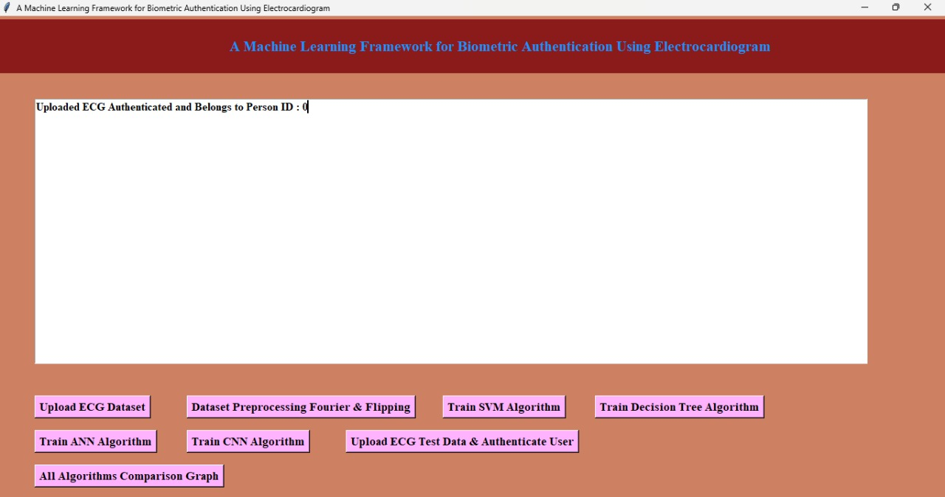
Result:

Slide 14
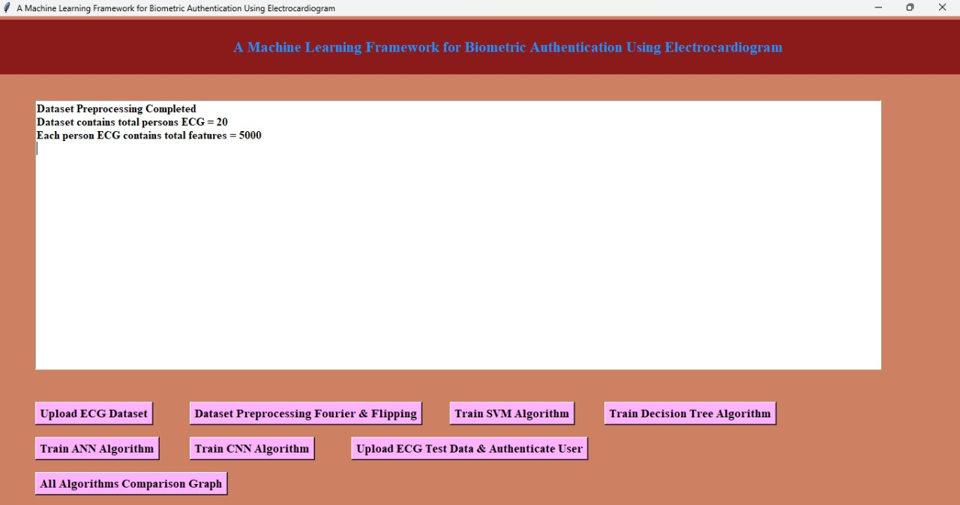
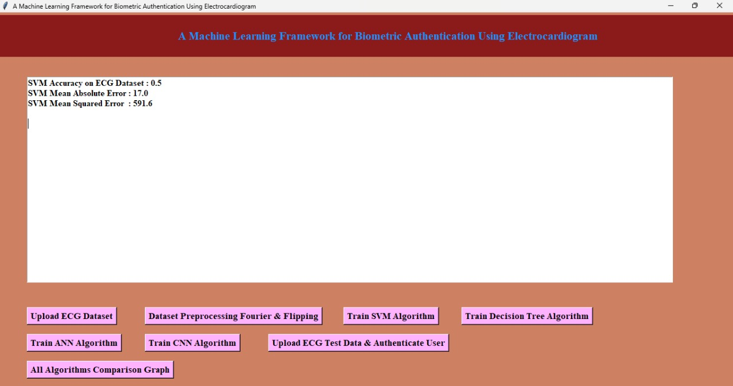

Slide 15
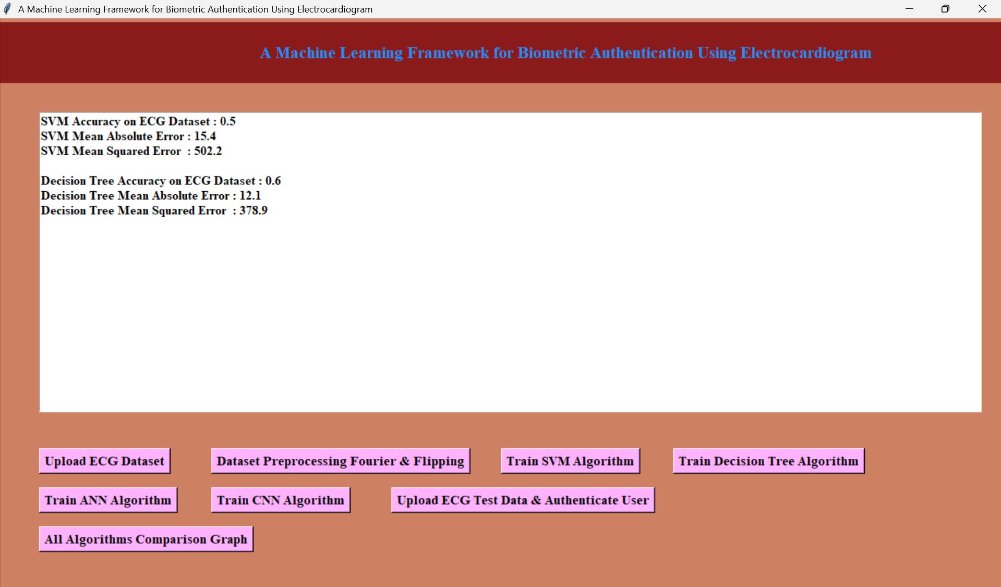
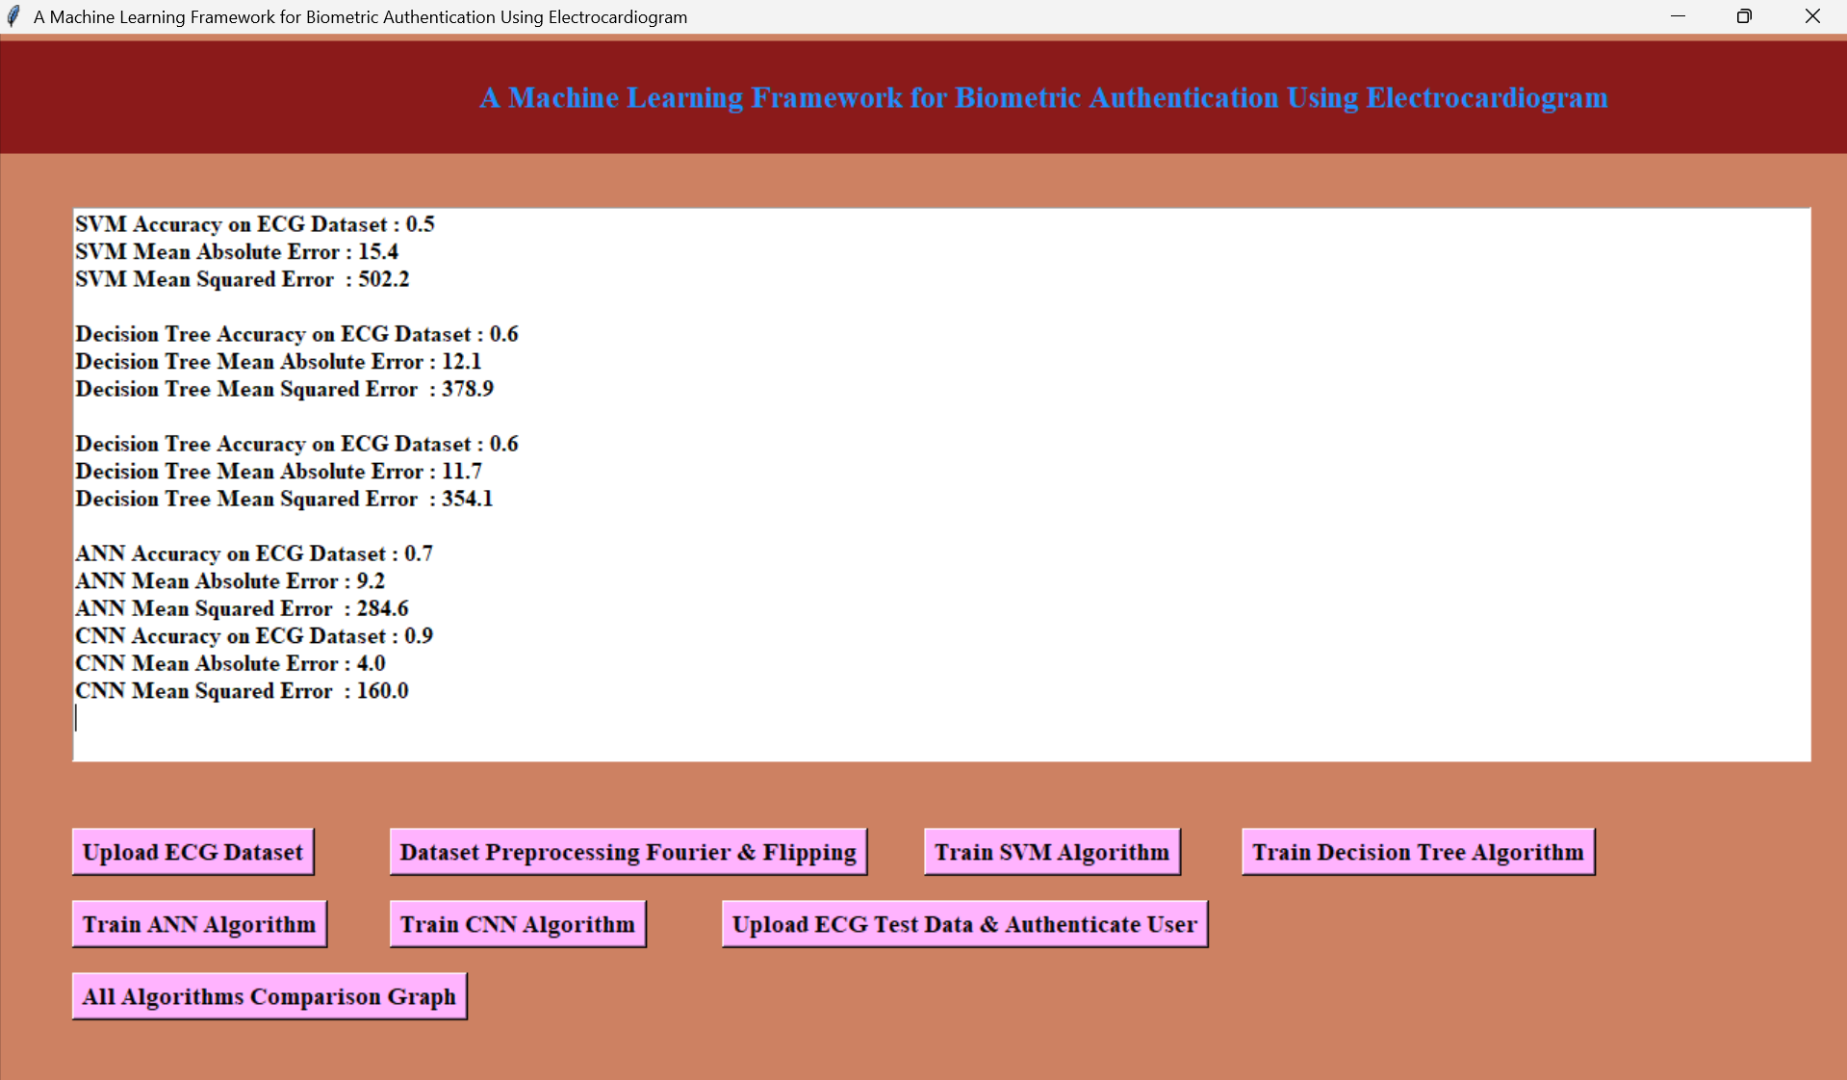

Slide 16
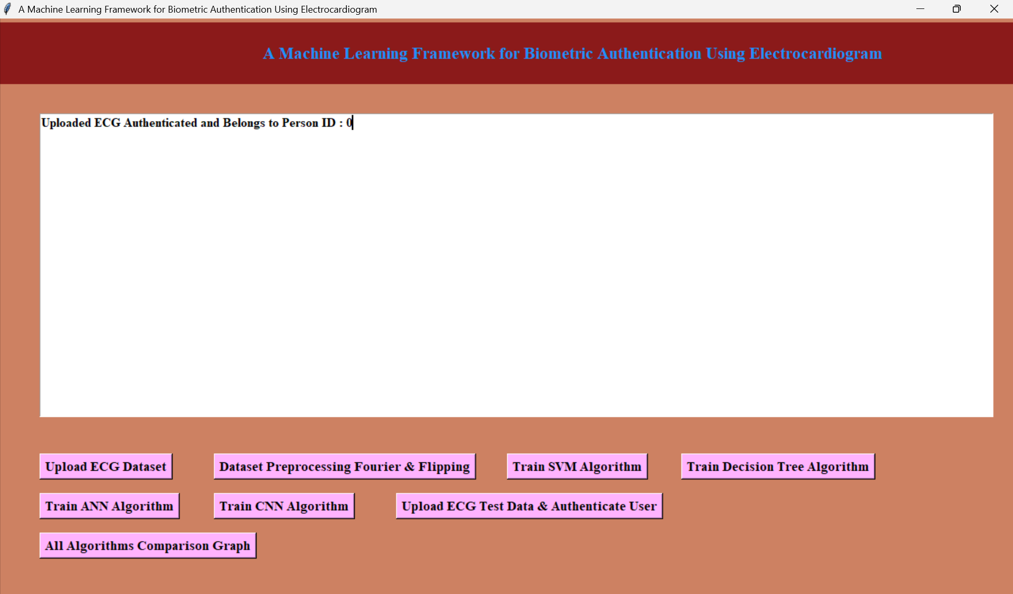
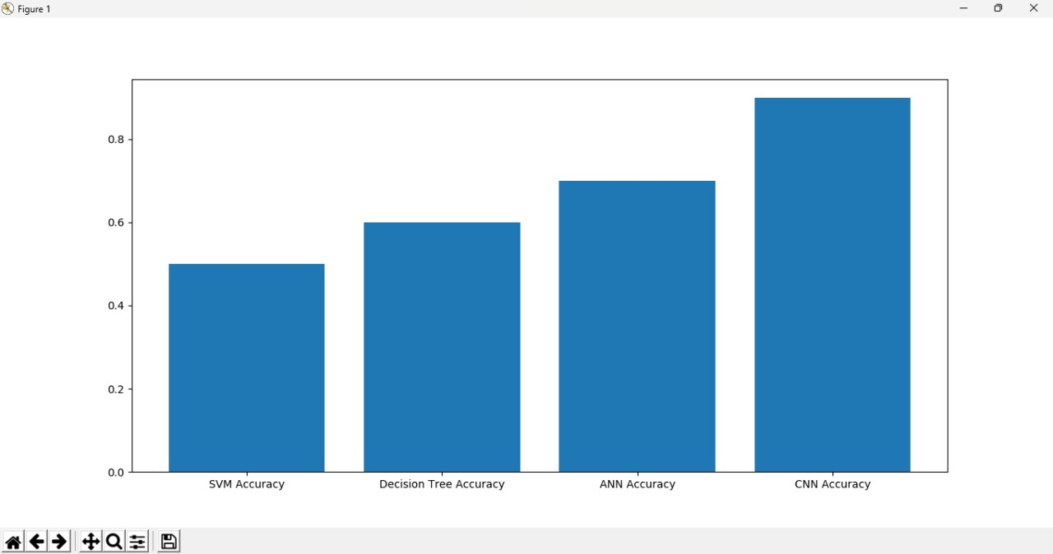

Slide 17
ADVANTAGES:
The goal of brain tumor segmentation is to generate accurate delineation of brain tumor regions with correctly located masks.
Brain tumor detection at early stages can increase the chances of the patient's recovery after treatment.
Brain tumor detection may help evaluate head injuries, strokes, Alzheimer's disease, and brain cancer.
Timely diagnosis allows for a wider range of treatment options, including less surgeries and targeted therapies.

Slide 18
APPLICATIONS:
Medical Applications:
Research Applications
Clinical Applications
Some of the most common methods for detecting brain tumors include:
1. Magnetic Resonance Imaging (MRI)
2. Computed Tomography (CT) scans
3. Positron Emission Tomography (PET) scans
4. Angiography
5. Biopsy

Slide 19
CONCLUSION:
In this study, segmentation and detection of brain tumor have been done using deep neural networks. In the present study, the MRI image dataset is used to train the neural network.
Secondly, the CNN model is implemented in particular for the three most popular kinds of brain tumor, i.e., glioma, meningioma, and pituitary.
The results obtained establish the efficiency of the proposed work when compared to the models already proposed in the literature.

Slide 20
FUTURE SCOPE:
The future of brain tumor detection holds immense promise, with advancements in imaging, AI, and personalized medicine leading the way.
Improved Imaging Techniques: Enhanced MRI, CT, and PET scans.
Artificial Intelligence (AI) Integration: Automated tumor detection and segmentation.
Point-of-Care Devices: Portable, bedside brain tumor detection.
Personalized Medicine: Genomic-based treatment planning

Slide 21
REFERENCES:
[1] G. Alain and Y. Bengio, "What regularized auto-encoders gain from the data making allotment," J. Mach. Learn. Res., vol. 15, no. 1, pp. 3563–3593, 2014.
[2] M. R. Avendi, A. Kheradvar, and H. Jafarkhani, "A solidified significant learning and deformable-model approach to manage totally customized division of the left ventricle in heart MRI," MedIA Image Anal., vol. 30, pp. 108–119, May 2016.
[3] M. R. Avendi, A. Kheradvar, and H. Jafarkhani, "Modified division of the right ventricle from heart MRI using a learning-based system," in Magnetic Resonance in Medicine. New York, NY, USA: Wiley, Feb. 2017, doi: 10.1002/mrm.26631.
[4] W. Bai et al., "A bi-ventricular cardiovascular guide book worked from 1000+ significant standards MR pictures of sound subjects and an examination of shape and development," MedIA Image Anal., vol. 26, no. 1, pp. 133–145, 2015.
[5] W. Bai et al., "A probabilistic fix based name blend model for multiatlas division with selection refinement: Application to cardiovascular MR pictures," IEEE Trans. Medication. Picture. vol. 32, no. 7, pp. 1302–1315, Jul. 2013.

Slide 22
THANK YOU

